Slide 1


Life and Death: Contrasting Health Realities in Rural and Urban America
By: Adithya and Ahmad

Slide 2
Main Goal of our Research
To compare different causes of death on a county level
We looked at data for the years 2014 to 2018 for all the causes of death
We got all our data from https://www.ahrq.gov/sdoh/data-analytics/sdoh-data.html#download
We looked at different variables such as self-harm, drug overdose, etc.

Slide 3
Classification of Rural and Urban Counties
Metropolitan Statistical Areas (MSA): Metropolitan counties are those that include a city with a population of at least 50,000 people, along with adjacent counties that are socially and economically integrated with the urban core.
Micropolitan Statistical Areas: Micropolitan counties are similar to metropolitan counties but have an urban core with a population between 10,000 and 50,000 people.
Non-Metropolitan or Rural Areas: Non-metropolitan counties are those that do not contain a city with a population greater than 50,000 or an urbanized area with a population greater than 50,000.

Slide 4

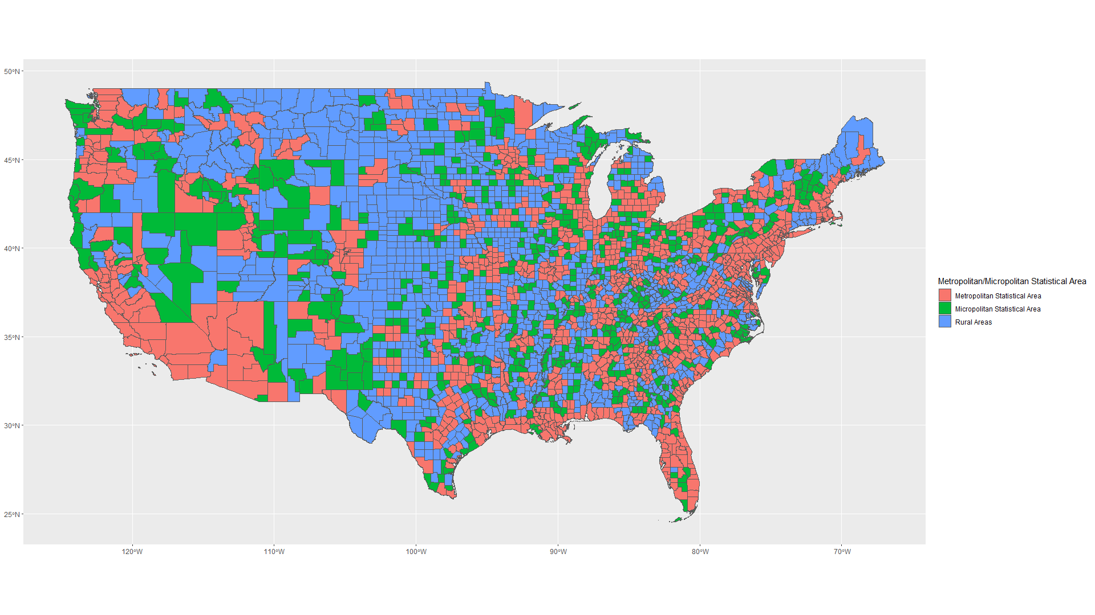

Slide 5
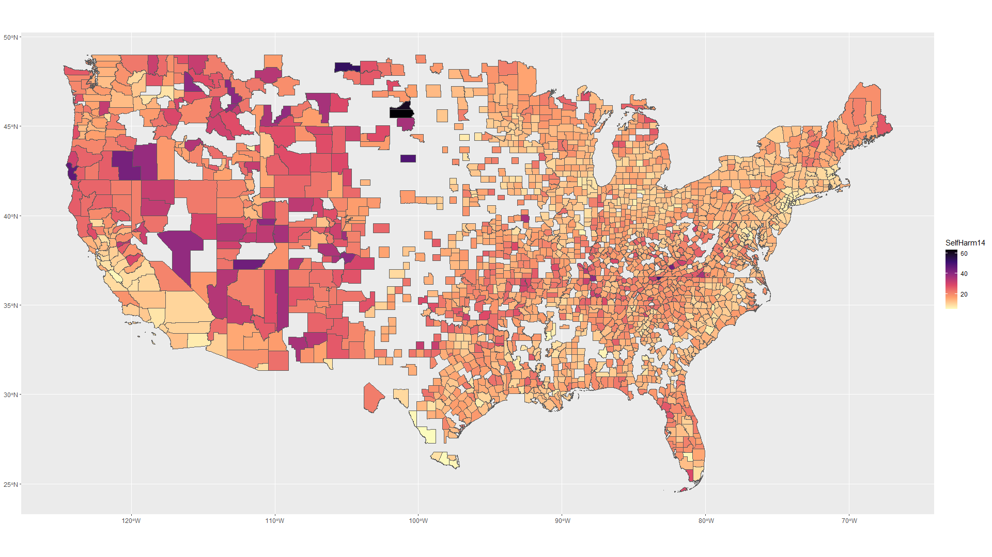

Slide 6
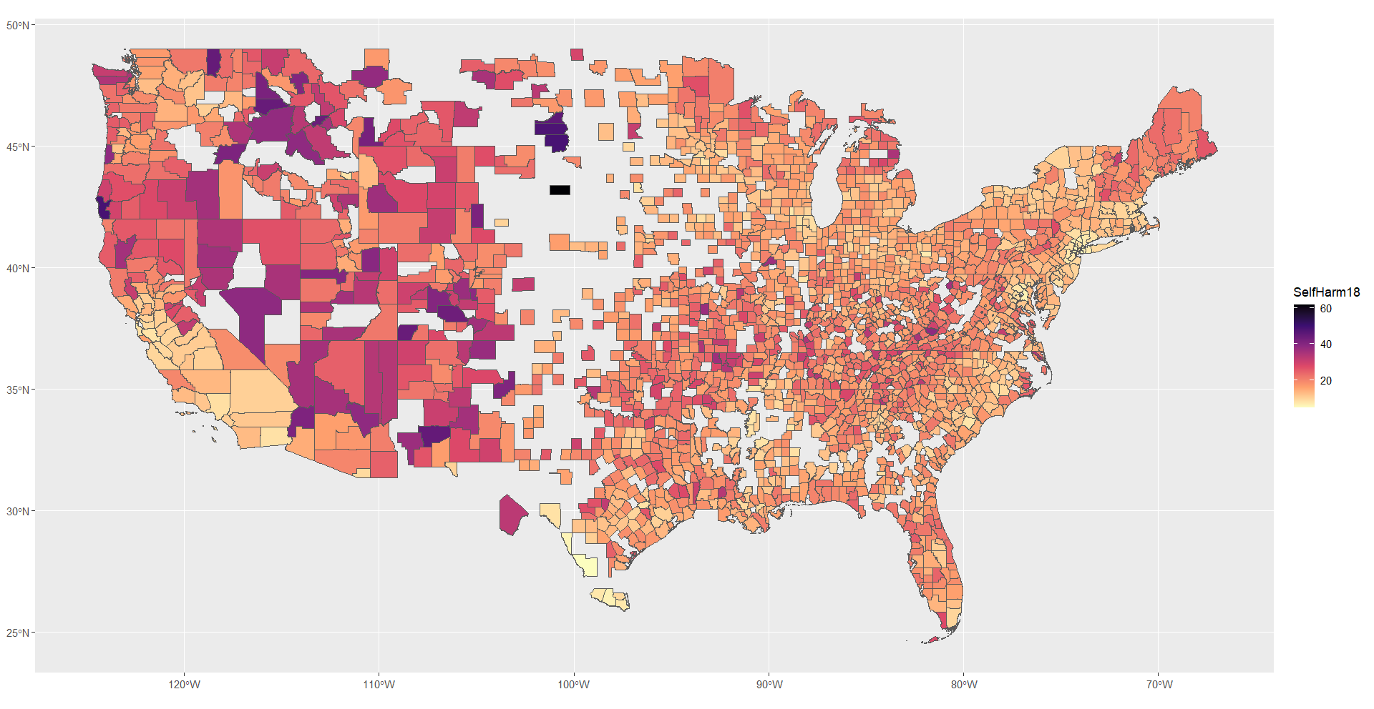

Slide 7
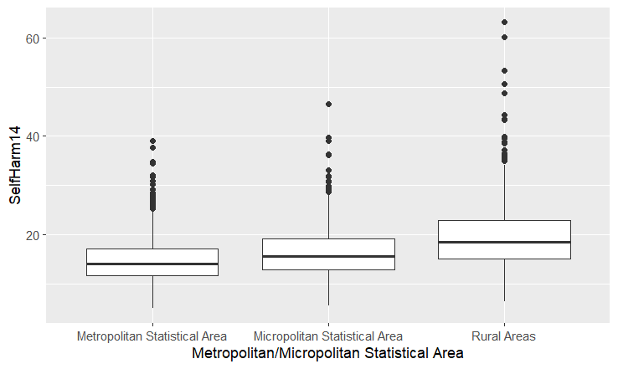
Boxplot for Self Harm during the year 2014
The frequency for metro/micro counties is higher than rural.
But the rate is higher for rural counties even though the frequency is less than others.

